Slide 1

All India Women Hackathon
CODERS

Slide 2
AI IN CYBERSECURITY FOR SECURE DIGITAL TRANSACTIONS AND DATA TRANSMISSIONS
Problem Statement:
In the age of digital transactions and data transmissions, cyber threats like phishing, malware, and man-in-the-middle attacks are prevalent. These threats compromise the security of sensitive information, causing financial losses and damaging trust. Traditional security measures often fall short due to the evolving nature of cyber threats. There is a need for a robust, adaptive security system that can detect and mitigate these threats in real-time.
Solution:
To develop an AI-driven cybersecurity platform that enhances the security of digital transactions and data transmissions. The platform will utilize machine learning algorithms to detect anomalies, predict potential threats, and take proactive measures to prevent breaches.

Slide 3
KEY FEATURES OF THE SOLUTION
Anomaly Detection
Predictive Threat Analysis
Automated Response
Encryption and Secure Protocols
User Behaviour Analysis

Slide 4
PRIORITIZING SUSTAINABILITY
Efficient Resource Utilization: Optimized Algorithms like Isolation Forest is used.
Green Computing Practices: Server Virtualization and efficient data.
Data Management: Data reduction techniques were implemented.
Data Minimization: Collected and Processed necessary data.

Slide 5
ETHICAL CONSIDERATIONS
Privacy and Data Protection : Data Encryption and data minimization.
Transparency and Accountability includes model explainability and documentation .
Ethical Guidelines: Following ethical guidelines for Ai use including principles for responsible AI development and deployment.
User Control and Consent : Allow users to access , correct or delete their data.

Slide 6
Outcome and Methodology
Methodology:
Data Collection and Preprocessing: Used fraud detection dataset for evaluating.
Model Training : Used the Isolation Forest Algorithm for anomaly detection.
Anomaly Detection and Evaluation: Used the trained model to predict anomalies. Verified the number of detected anomalies.
Output Verification: Cross verified detected anomalies with known data points to verify accuracy.
Documentation and Reporting: Documentation including model parameters and evaluation metrics.

Slide 7
Outcome and Methodology
Outcome:
Anomaly Detection: The Isolation Forest Algorithm successfully identified the anomalies in the dataset.
Performance Metrics: The model’s performance was evaluated by detecting anomalies.
Visual Insights: Visualizations highlighted the distribution of detected anomalies.

Slide 8
Metrics For Isolation Forest Algorithm
Precision , Recall and F1 Score
Confusion Matrix
Area under the Receiver Operating Characteristic Curve (ROC-AUC)
Area Under the Precision – Recall Curve (PR-AUC)

Slide 9
IMPLEMENTATION PLAN
Defining Objective and Scope
Data Collection and Preparation
Model Development
Model Evaluation
Integration and Deployment
Monitoring and Maintenance
Documentation and Training
Review and Feedback

Slide 10
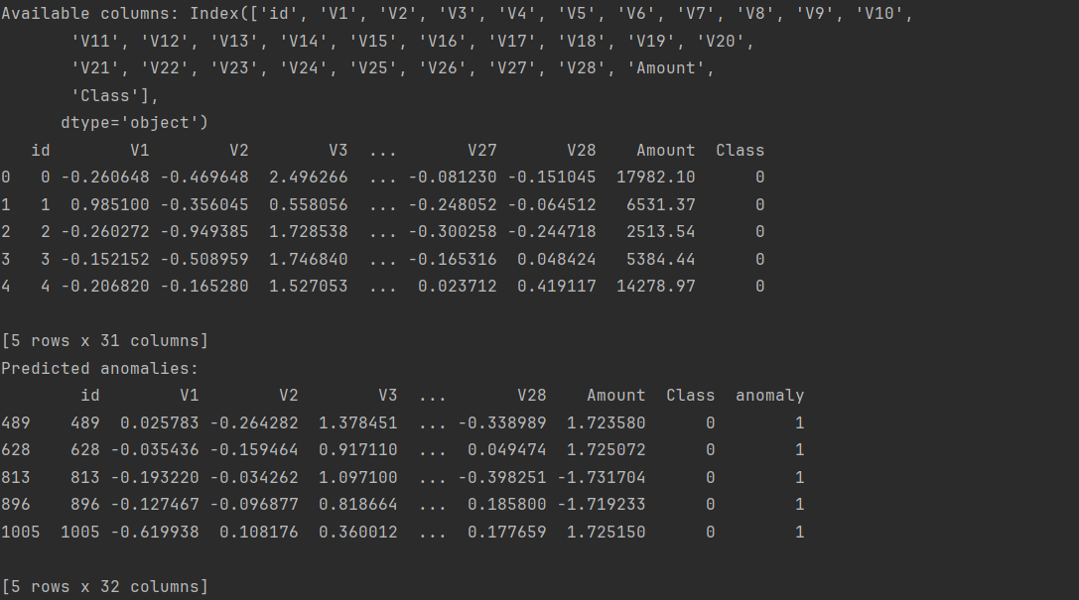
Screen Shots of Output after Implementation

Slide 11
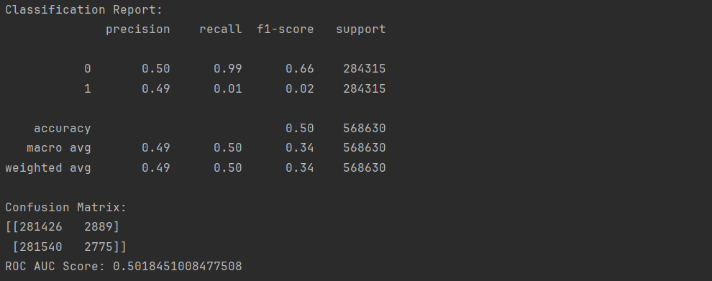
Screen Shots of Output after Implementation

Slide 12
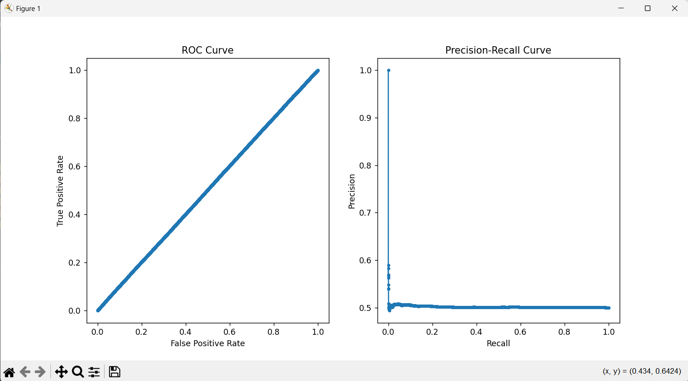
Screen Shots of Output after Implementation

Slide 13
POTENTIAL CHALLENGES
Data Quality and Availability :
Challenge: Incomplete ,noisy or biased data can affect model performance.
Solution: Implementation of robust data preprocessing techniques.
Model Performance and Accuracy:
Challenge: Models may produce false positive or false negatives affecting reliability.
Solution: Continuous evaluation using metrics.
Scalability:
Challenge: Handling Large volumes of real-time data can strain system resources.
Solution: Utilize scalable cloud infrastructure and optimize model performance.
Data Privacy and Security:
Challenge: Protecting sensitive data while ensuring compliance with regulations is critical.
Solution: Implementation of strong encryption.

Slide 14
IMPACT OF SUCCESSFUL DEPLOYMENT
Enhanced Security
Operational Efficiency
Regulatory Compliance
Customer Trust and Satisfaction
Scalability and Adaptability
Cost savings
Enhanced Decision Making

Slide 15
RoadMap
Week1:
Project Planning and Requirements gathering:
Data Collection and Preparation
Model Development – Isolation Forest
Week2:
Integration and Deployment
Monitoring
Maintenance

Slide 16
Business Value
Enhanced Security and Fraud Prevention
Cost Savings
Improved Customer Trust and Satisfaction
Regulatory Compliance
Competitive Advantage
Scalability and Efficiency
Data- Driven Insights

Slide 17
INNOVATION AND IMPACT
Real-time Anomaly Detection
Predictive Analytics
Automated Response mechanism
Privacy and Fairness

Slide 18
Deployment Plan and Integration
Deployment Plan:
Preparation of Environment like infrastructure and dependencies has python and necessary libraries installed.
Deployment Strategy through Testing.
Security Measures where encrypting sensitive data takes place.
Integration Plan:
API Integration where they interact with the anomaly detection model.
Data Flow Integration: Mechanisms to ingest transaction data from various sources.
User Interfaces and Alerts
Testing and Validation

Slide 19
Recommendations and Next Steps
Recommendations:
Model Enhancement
Data Quality
Model Evaluation
Scalability
User Feedback
Compliance and Security

Slide 20
Recommendations and Next Steps
Next Steps:
Deploy the Model
Integrate with Systems
Set Up Monitoring and Alerts
Document and Train
Establish Feedback Loop
Plan for Maintenance
Evaluate Performance
Expand Use Cases

Slide 21
Key Learnings
Understanding Isolation Forest
Data Preprocessing
Model Implementation
Evaluation Metrics
Deployment
Integration
Security and Compliance
Continuous Improvement
Documentation and Training
Scalability

Slide 22
THANK YOU

